Slide 1
Recent developments in the Australian IP landscape
Greg Chambers, Partner
November 2019

Slide 2
Top 10 of 2019
‘Someone You Loved’ – Lewis Capaldi
‘Circles’ – Post Malone
‘Senorita’ – Shawn Mendes & Camila Cabello
‘Good As Hell’ – Lizzo
‘Memories’ – Maroon 5
‘Truth Hurts’ – Lizzo
‘No Guidance’ – Chris Brown ft. Drake
‘Lose You To Love Me’ – Selena Gomez
‘Panini’ – Lil Nas X
’10,000 Hours’ – Dan + Shay & Justin Bieber

Slide 3
Top 10 IP happenings of 2019
A list of those events this year involving intellectual property which I saw has having the most interest. Sadly, IP Australia does not maintain a top 10.
Some have a New Zealand relevance and others not
Some picked for the drama and others for their importance to practice

Slide 4
#10 – Lundbeck
Australia’s longest running patent drama
Alphapharm successfully challenged the validity of the Lundbeck patent for LEXAPRO (the “+” enantiomer of citalopram). The extension of term application filed too late
Lundbeck failed to overturn this decision on appeal to Justice Lindgren and then to the Full Court and failed to secure special leave from the High Court
New patent term extension application filed on the last day before the expiry of the patent, together with an application for a decade long extension of time

Slide 5
#10 – Lundbeck (cont.)
The extension of time application was allowed but opposed by Alphapharm and others. The Commissioner found in favour of Lundbeck, as did the AAT, the Full Court of the Federal Court and the High Court (3:2)
The extension of term application was then opposed, but granted by the Commission with appeals to the Federal Court dismissed and the High Court refusing special leave
Lundbeck brought infringement proceedings against Sandoz and others

Slide 6
#10 – Lundbeck (cont.)
Finding by Jagot J that Sandoz infringing. An appeal has been filed
Application for a licence by Sandoz under s.223(9) made by Sandoz. After an appeal regarding the application of s.223(9), the Commission heard the application and granted a licence. No royalties are payable
s.223(9) provides: “Where the Commissioner grants an extension of more than three months for doing a relevant act…the preserved provisions have effect for the protection of persons who…exploited the invention concerned…”
No doubt further appeals to be pursued

Slide 7
#9 – Changes to trade mark removal
Section 93(2)
A non-use application on the ground mentioned in paragraph 92(4)(b) may only be made after a period of three years beginning from the date the particulars of the trade mark were entered into the Register under s.69
Still different to the New Zealand provision
This provision has effect with respect to applications filed on or after 24 February 2019
For all cases filed before 24 February 2019, the five year rule of old s.93(2) is said to apply

Slide 8
#9 – Changes to trade mark removal (cont.)
This is contentious, as there was no saving provision
Still retain discretion and therefore still at odds with New Zealand law
Procedures remain very different
For example:
Use of counter-statement in New Zealand
Obligation to file evidence with the counter-statement in New Zealand
Ease with which extensions of time for serving evidence can be secured in New Zealand compared with Australia

Slide 9
#8 – Trident Seafoods (Full Federal Court)
Trident Seafoods Corporation v Trident Foods Pty Ltd [2019] FCAFC 100
On appeal on an application to remove a registration for non-use
Mark used in relevant three year period
Question: Did the use accrue to the benefit of the registered owner?

Slide 10
#8 – Trident Seafoods (cont.)
Manassen the user, subsidiary of Trident Foods, the owner
Common directors, common place of business
At first instance, the answer was no. Use was not under the “actual” control of the registered owner
At first instance, it was decided that there must be control as a matter of substance. Despite non-use, the court exercised its distinction in favour of owner
Trident Seafoods appeal dismissed
On the Trident Foods Notice of Contention:
Common directors – “It must be inferred from the evidence that the two companies operated with a unity of purpose”
Distinguished Lodestar where there was no relationship other than a licence agreement

Slide 11
#7 – Calidad v Seiko
Calidad Pty Ltd v Seiko Epson Corporation [2019] FCAFC 115
Litigation concerned re-filled Epson ink cartridges
Seiko Epson alleged that the re-filling constituted a patent infringement
The patent question involved an examination of the extent to which there is an implied licence to restore products for re-use
Three judges. Three separate decisions

Slide 12
#7 – Calidad v Seiko (cont.)
All judges found that the activities went beyond the implied licence on sale to use and repair (but for different reasons)
The appellants included as a ground of appeal the doctrine of Exhaustion of Rights – but not argued
Looking to overturn decision of the Privy Council in National Phonograph Company v Menck
High Court has granted special leave (this week)

Slide 13
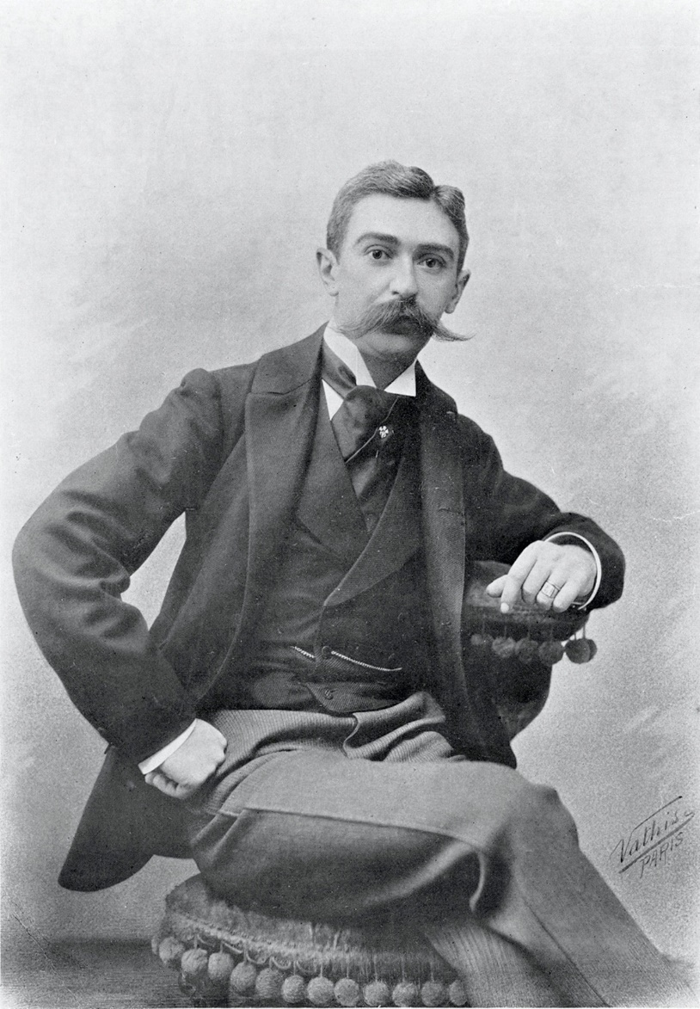
#6

Slide 14
#6 – Pierre de Coubertin trade mark oppositions AU and NZ
IOC opposed applications in Australia and New Zealand filed by Tempting Brands to register the name ‘Pierre de Coubertin’ for goods in a number of classes
IOC successful in Australia but unsuccessful in New Zealand (even on appeal)
The Australian decision ([2019] ATMO 41) is on appeal
The difference may be explained because of the attention given to s.43 of the Australian Trade Marks Act 1995 in the Australian case which has no direct counterpart in the New Zealand Act

Slide 15
#6 – Pierre de Coubertin trade mark oppositions AU and NZ (cont.)
S.43 “ An application for registration of a trade mark in respect of particular goods or services must be rejected if, because of some connotation that the trade mark has, the use of the trade mark in relation to those goods or services would be likely to deceive or cause confusion” c.f. s.17(1)(a) of the New Zealand Trade Marks Act (2002)
Greater focus in the New Zealand decision on the actual use made of the mark by IOC
Little evidence led by the IOC in New Zealand on the extent to which the name Pierre de Coubertin is known in New Zealand

Slide 16
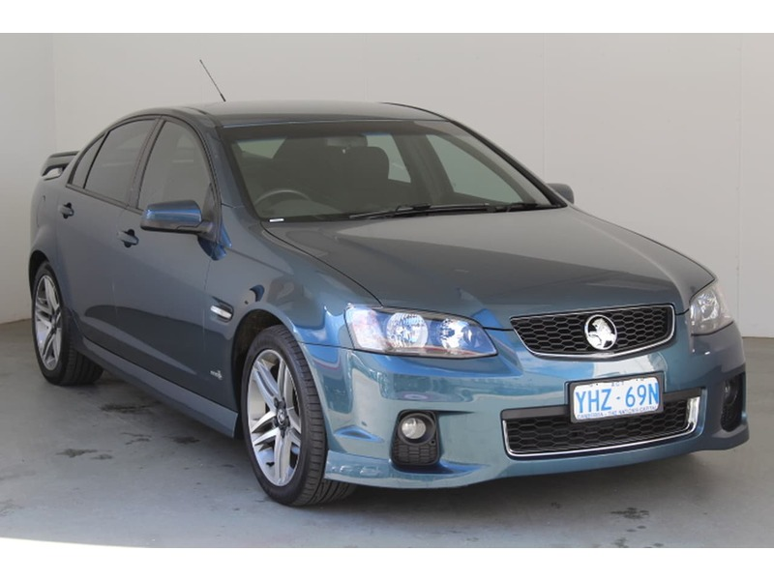
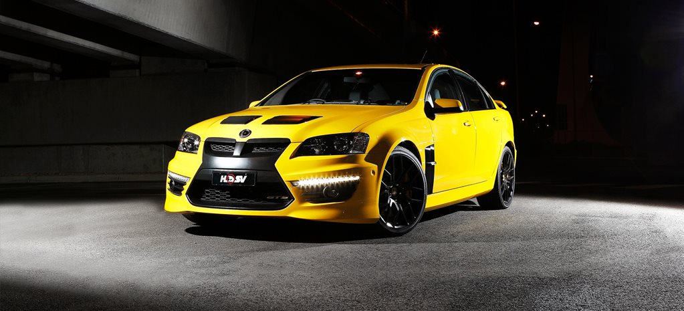
#5

Slide 17
#5 – GM Global Technology v S.S.S. Auto Parts Pty Ltd
Design law in Australia is different from design law in New Zealand in a number of respects. The term of a registered design in Australia is 10 years. In New Zealand 15 years. Australia does not have overlapping rights in copyright as there is in New Zealand. In Australia there is a spare parts defence which does not have a counterpart in New Zealand.
s.72 of the Australian Designs Act 2003
(1) Despite sub-section 71(1), a person does not infringe a registered design if …
(b) the product is a component part of a complex product; and
(c) the use…is for the purpose of repair of the complex product so as to restore its overall appearance in whole or part
(2) … the registered owner of the design bears the burden of proving that the person knew, or ought reasonably to have known, that the use was not for the purpose mentioned in paragraph (1)(c).

Slide 18
#5 – GM Global Technology v S.S.S. Auto Parts Pty Ltd
S.S.S. was able to avail itself of the defence as it went to some lengths to ensure that its parts were sold only for repair
Only in those cases where GM could show that a reasonable person ought to have known that the use was not for repair were the sales found to be infringing. These arose in cases where the sales were to customers whose names suggested the use for a vehicle upgrade rather than a simple repair

Slide 19
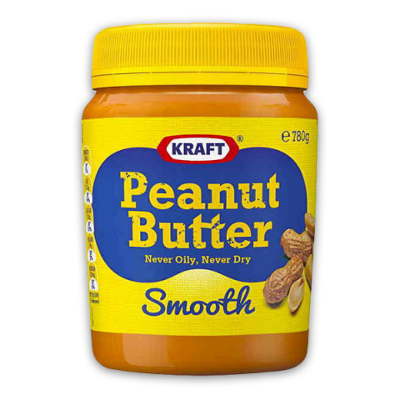
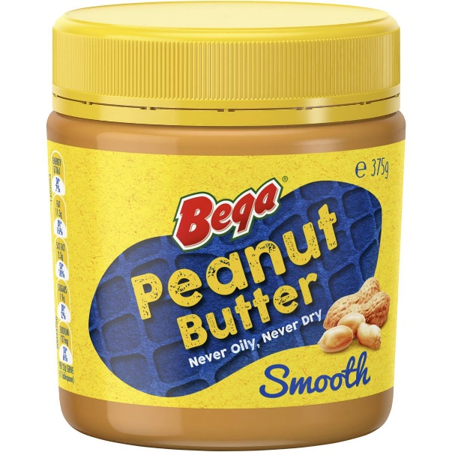
#4 – Kraft v Bega

Slide 20
#4 – Kraft v Bega (cont.)
Competing claims with respect to the trade dress
Kraft Australia used the trade dress for many years
Kraft Australia became part of the Mondelez Group. At the same time, there was a purported assignment of the rights in the trade dress to a company in the Kraft Group. Mondelez received a licence back.
Mondelez sold its peanut butter business to Bega in 2017 (included all of its assets )
Kraft said that the goodwill was theirs (through assignment). Bega said that it was theirs through the acquisition of the Mondelez business
The court found for Bega

Slide 21
#4 – Kraft v Bega (cont.)
Goodwill in trade dress inseparable from the business which uses it and is not assignable at common law
Licensing of common law marks not possible
On appeal
Registration under the Trade Marks Act 1995 overcomes these issues

Slide 22
#3 – IPH merger with Xenith
First public listing IPH Limited (Spruson and Ferguson) 2015
Second public listing Xenith Limited (Shelston Waters) 2015
Third public listing Qantm Limited (DCC, Freehills Patent Attorneys) 2016
IPH first acquired Pizzeys 2015. Then Callinans (2015), Cullens (2016), Fisher Adams Kelly (2017), AJ Park (2017) – tried buying Qantum (2018), Xenith (15 August 2019)

Slide 23
#3 – IPH merger with Xenith (cont.)
Xenith in the meantime progressively purchased Glasshouse Advisory, Griffith Hack and Watermark
IPH therefore now comprises:
Spruson & Ferguson
Griffith Hack
Watermark
Shelstons
AJ Park
Cullens
Pizzeys
Fisher Adams Kelly
Callinans

Slide 24
#3 – IPH merger with Xenith (cont.)
Market capitalisation of IPH about $1.9 billion
Qantm and Xenith announced merger discussions in 2019
IPH purchased blocking stake
Ultimately IPH successful in acquiring Xenith
Qantm left out in the cold. Market capitalisation 176 million and a P/E ratio of 15
IPH P/E ratio: 32

Slide 25
#2 – Encompass v InfoTrack
Encompass Corporation Pty Ltd v InfoTrack Pty Ltd [2019] FCAFC 161
Full Court of Federal Court – five judges
Interveners – IP Australia and IPTA
Build up was for a major review of Manner of Manufacture
Did not eventuate
Confirmation of Research Affiliates and RPL Central decisions
Ingenuity test of IP Australia not addressed

Slide 26
#2 – Encompass v InfoTrack
IPTA Submission:
“In the context of computer-implemented methods…a key consideration will be whether the alleged ingenuity resides in the way in which the method is implemented in the computer (in which case, the alleged invention may be patentable) or whether the ingenuity lies only in an unpatentable method or scheme (in which case, the alleged invention will not be patentable) “

Slide 27
#2 – Encompass v InfoTrack
Summarised form of method claim:
generating a network representation by querying remote data sources;
causing the network representation to be displayed to a user;
in response to user input commands, determining at least one user-selected node corresponding to a user-selected entity;
determining at least one search to be performed in respect of the corresponding entity associated with the (at least one) selected node;
Performing at least one search to determine additional information regarding the entity from at least one of a number of remote data sources by generating a search query; and
Causing any additional information to be presented to the owner

Slide 28
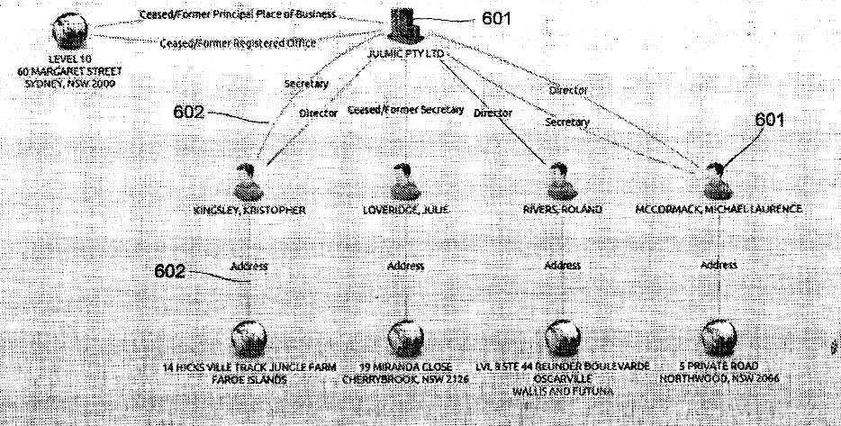
#2 – Encompass v InfoTrack

Slide 29
#2 – Encompass v InfoTrack
“…the terminology of an “artificially created state of affairs of economic significance” as used in NRDC, was not intended to be, and should not be seen as, a definition of “manner of manufacture” given that, in the same case, the High Court “had denounced the idea of an exact formula”

Slide 30
#2 – Encompass v InfoTrack
“…satisfaction of such a formulation does not, in any event, mandate a finding of inherent patentability, although this is not to say that it will not suffice for a large class of cases in which there are no countervailing considerations”

Slide 31
#2 – Encompass v InfoTrack
“none of the steps, individually or collectively, amount to anything more than a method in which an uncharacterised electronic processing device (for example, a computer) is employed as an intermediary to carry out the method steps – where the method itself is claimed in terms which amount to no more than an abstract idea or scheme”

Slide 32
#1 – Abolition of the Innovation Patent
It seems likely now that the system for protecting inventions through the Innovation Patent System will be phased out
However, there must now be a further review – to be finished within 12 months of the repeal Act Commencement date
In the interim and for 18 months after the commencement date it will still be possible to file applications for innovation patents

Slide 33
#1 – Abolition of the Innovation Patent (cont.)
Even after then, it will still be possible to file applications for Innovation Patents based on existing applications – either as divisionals or conversions
Phase out likely to commence in about June 2021, but possible innovation patent filings up until June 2029!

Slide 34
Thank you
Questions?

